Slide 2
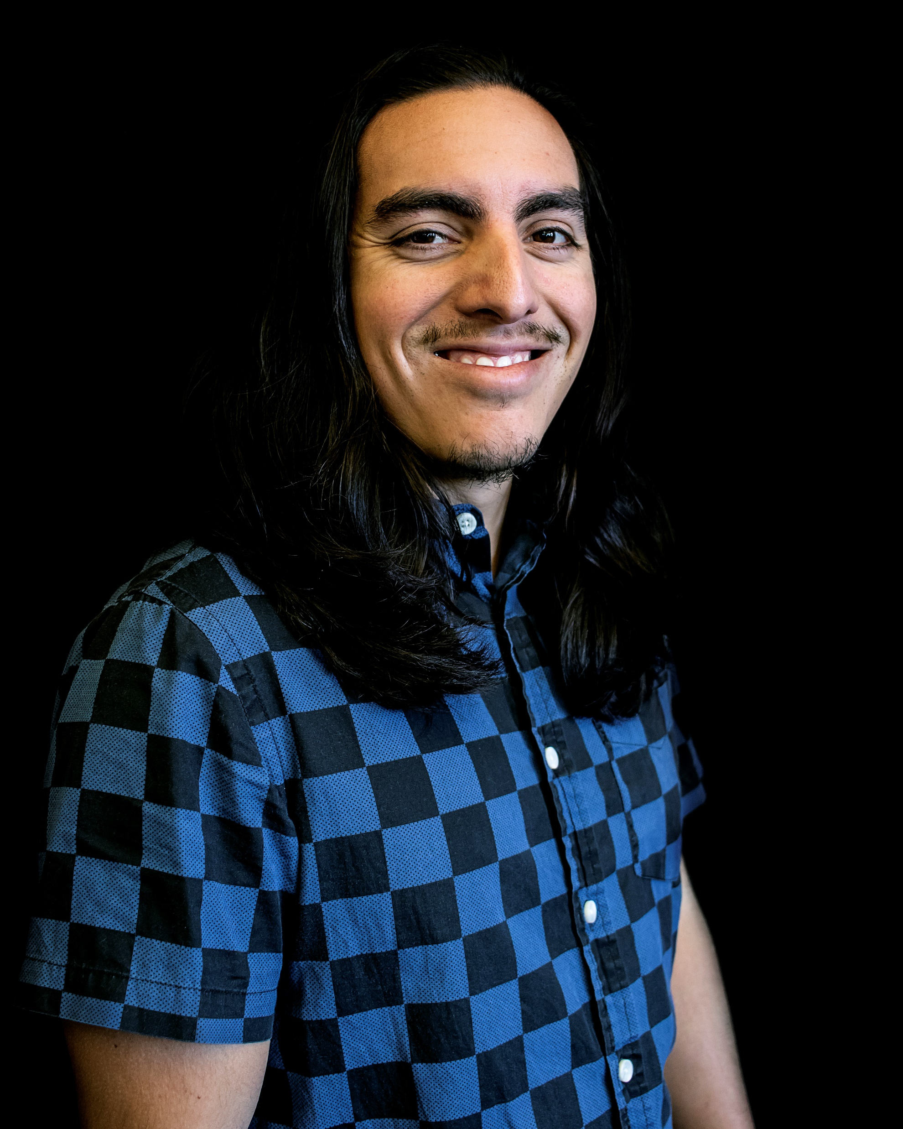
Who are we?
← Rice Enright
DJ Villegas →

Slide 3
What do we do?
Apt 4 Music’s mission is to create opportunity in the musical arts by making music accessible and achievable for anyone with an aptitude for it. Supporting musical arts on a global level starts with community, and it is our goal to facilitate this through music centered programs, services, and education.

Slide 4
Our Core Values
Inspire -An individual is inspired by the musical arts through exposure and access
Educate -With that inspiration, they strive to know more. They want to be educated.
Empower -Through education, they are empowered. They have the confidence to step on stage and perform. They are confident in their skillset and their value.
Lead -Their inspiration, education, and empowerment culminates into leadership, and this individual will go out into the world and inspire the next person, thus sharing and starting the whole cycle over again, so on, and so forth.

Slide 5
Our Programs
Individual lessons
Traditional instrument instruction
Group experiences
Music Makers Club (ages 6-10)
Creator Collab (ages 10-13)
Uke Jams (all ages)
Vendor Collaborations
Holiday and seasonal workshops with our neighbors in the Arts District Liberty Station ranging from music, to drawing, to yoga and more!

Slide 6
Our Programs cont.
Entertainment Services
Kid concerts and recitals
Musical acts
Event productions
Supplemental Music Education
Charter school services
Home school programs
In person or online
Miscellaneous
Instrument setups & repairs
Retail
Equipment & facility rentals
Video & streaming

Slide 7
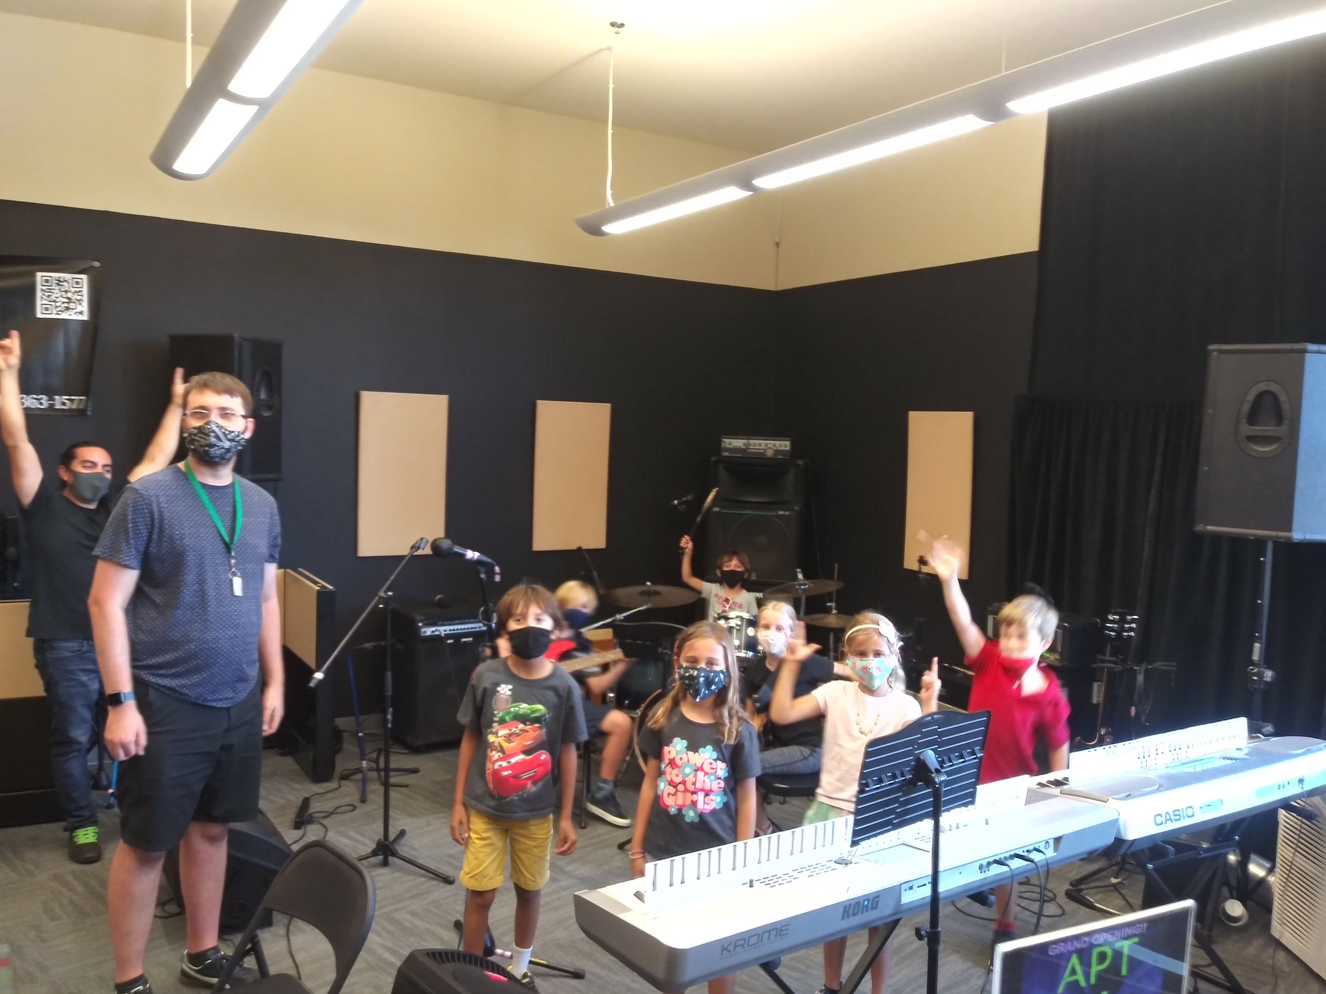

Slide 8
Affiliates
Julian Charter Schools
Pacific Coast Academy
Advocacy For Youth
Liberty Schools
Friends of NTC
Neighboring vendors within the Arts District Liberty Station

Slide 9
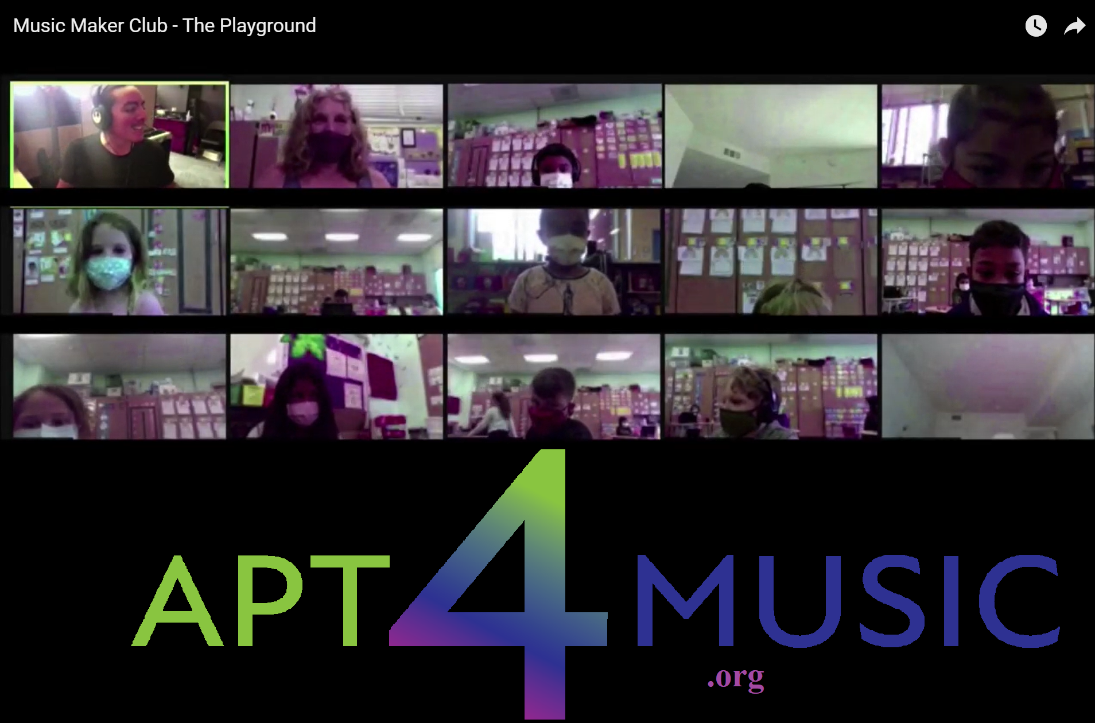

Slide 10
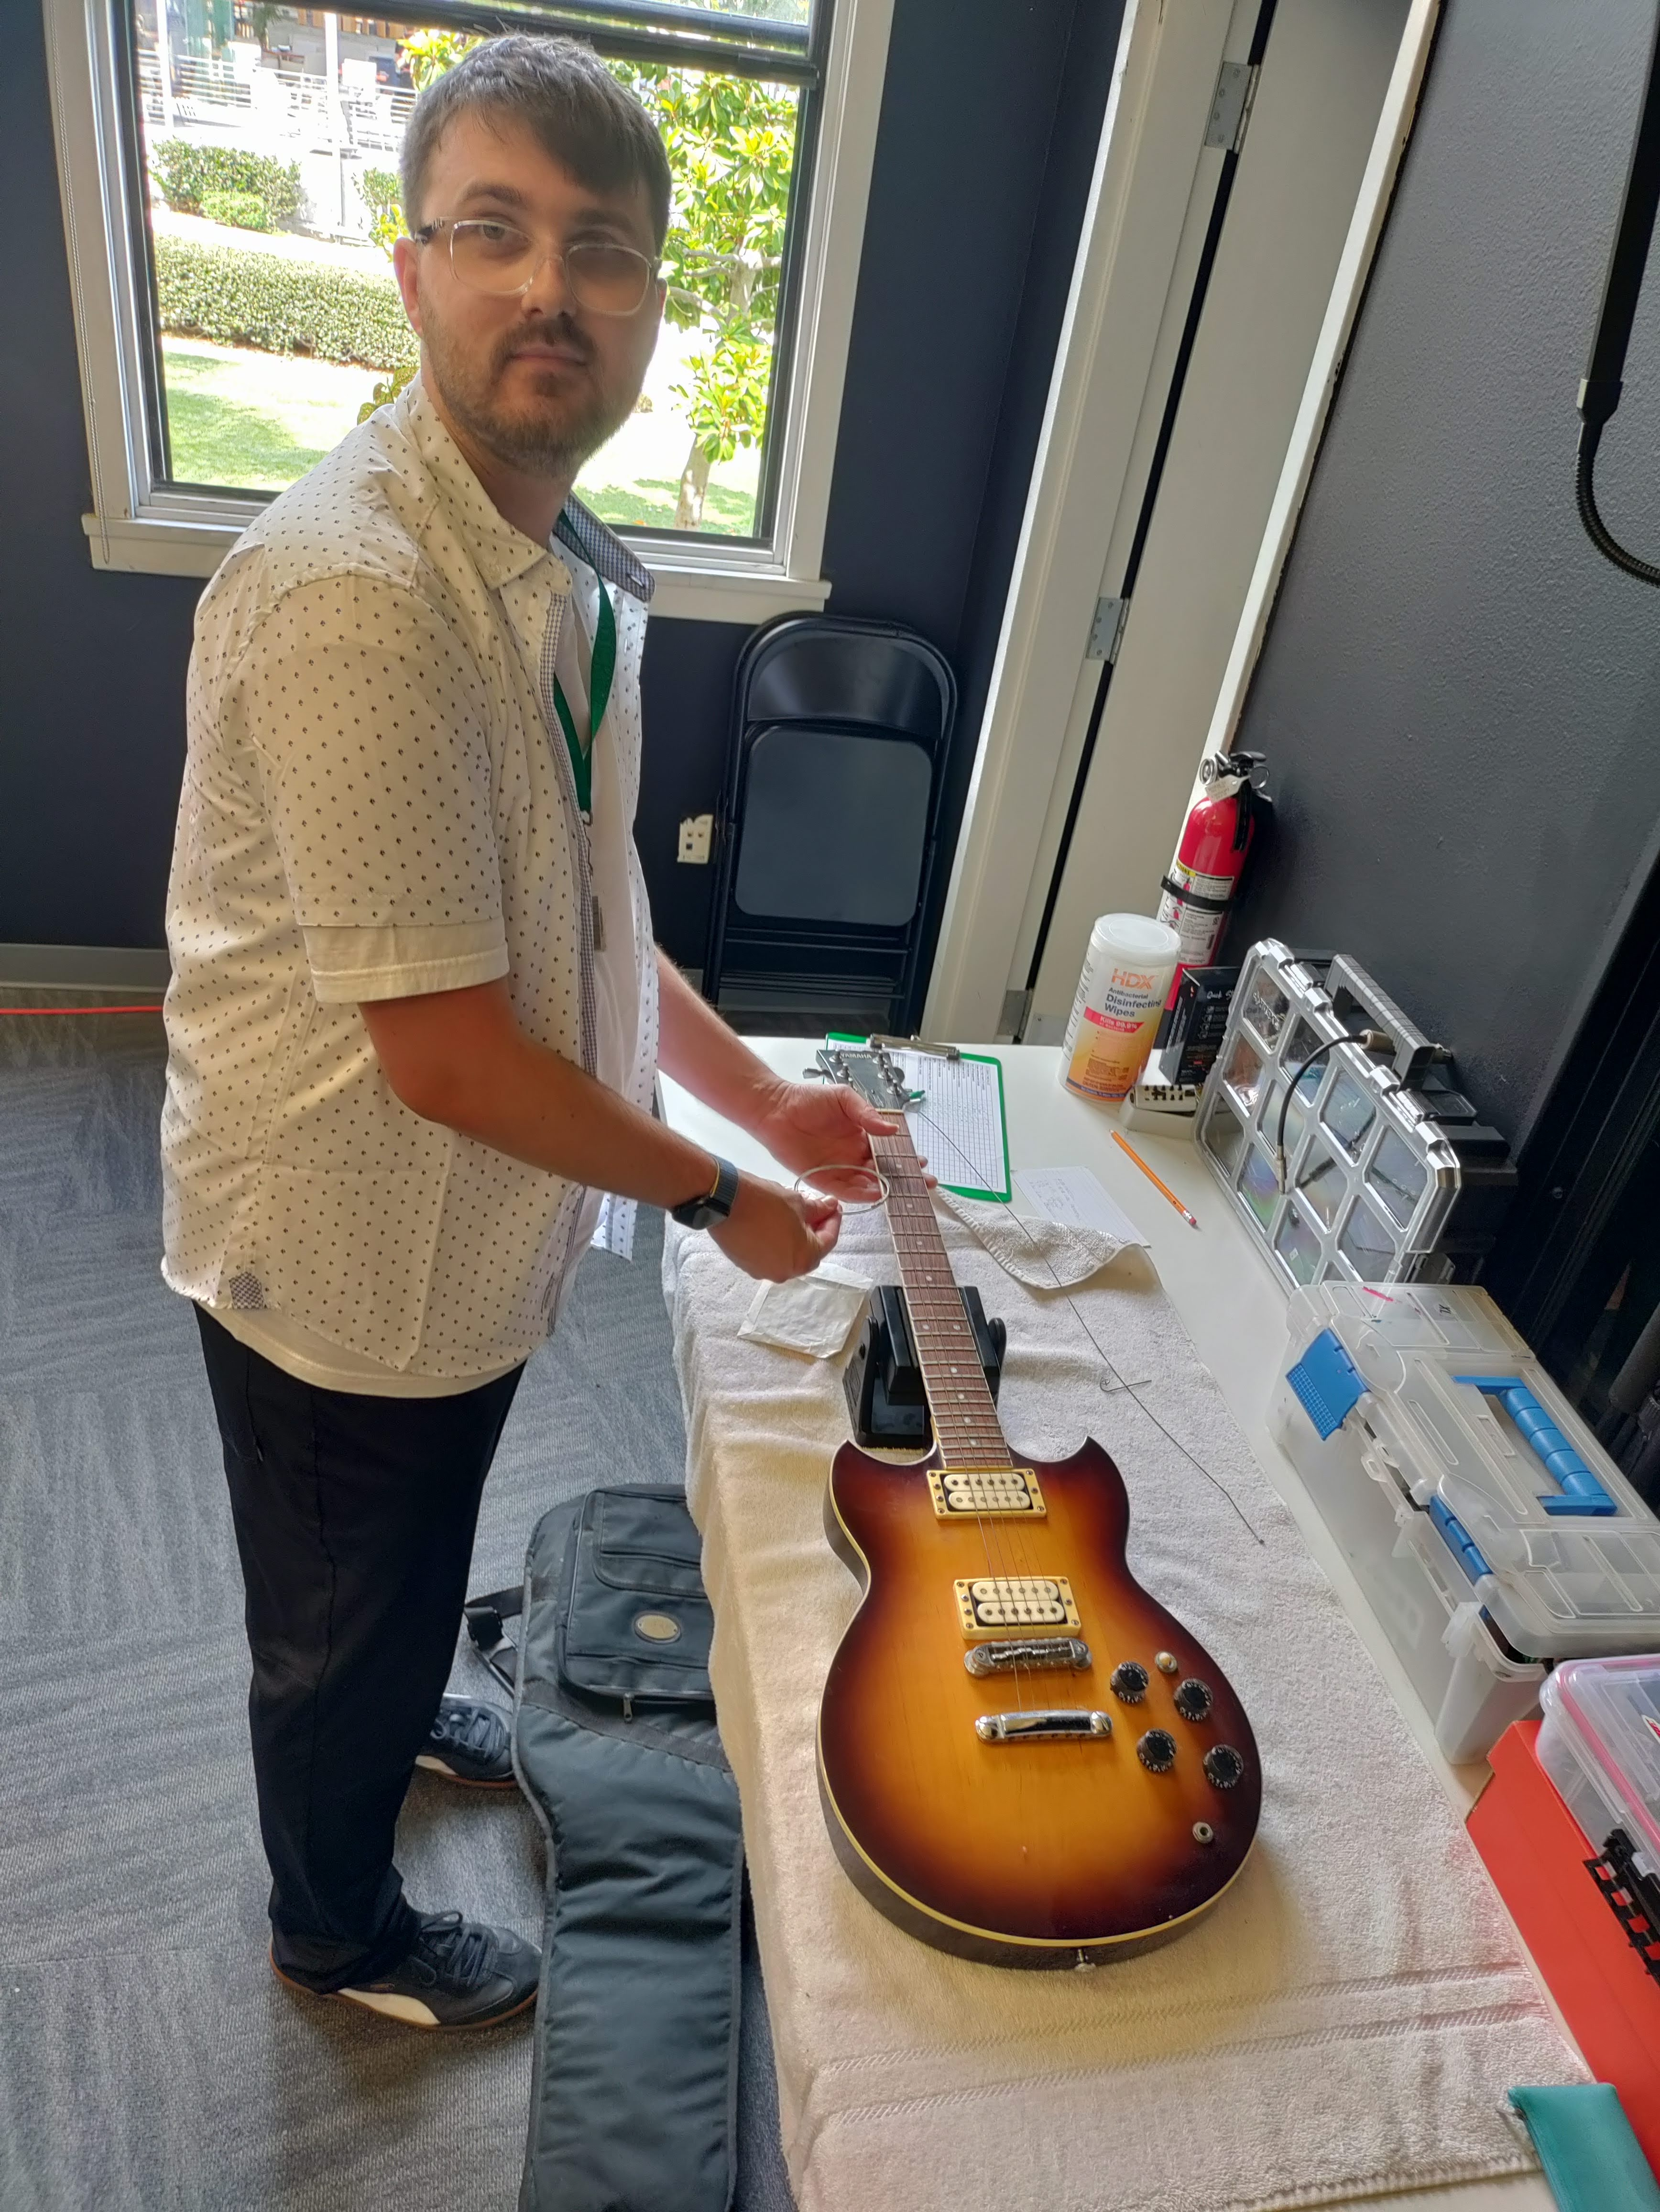
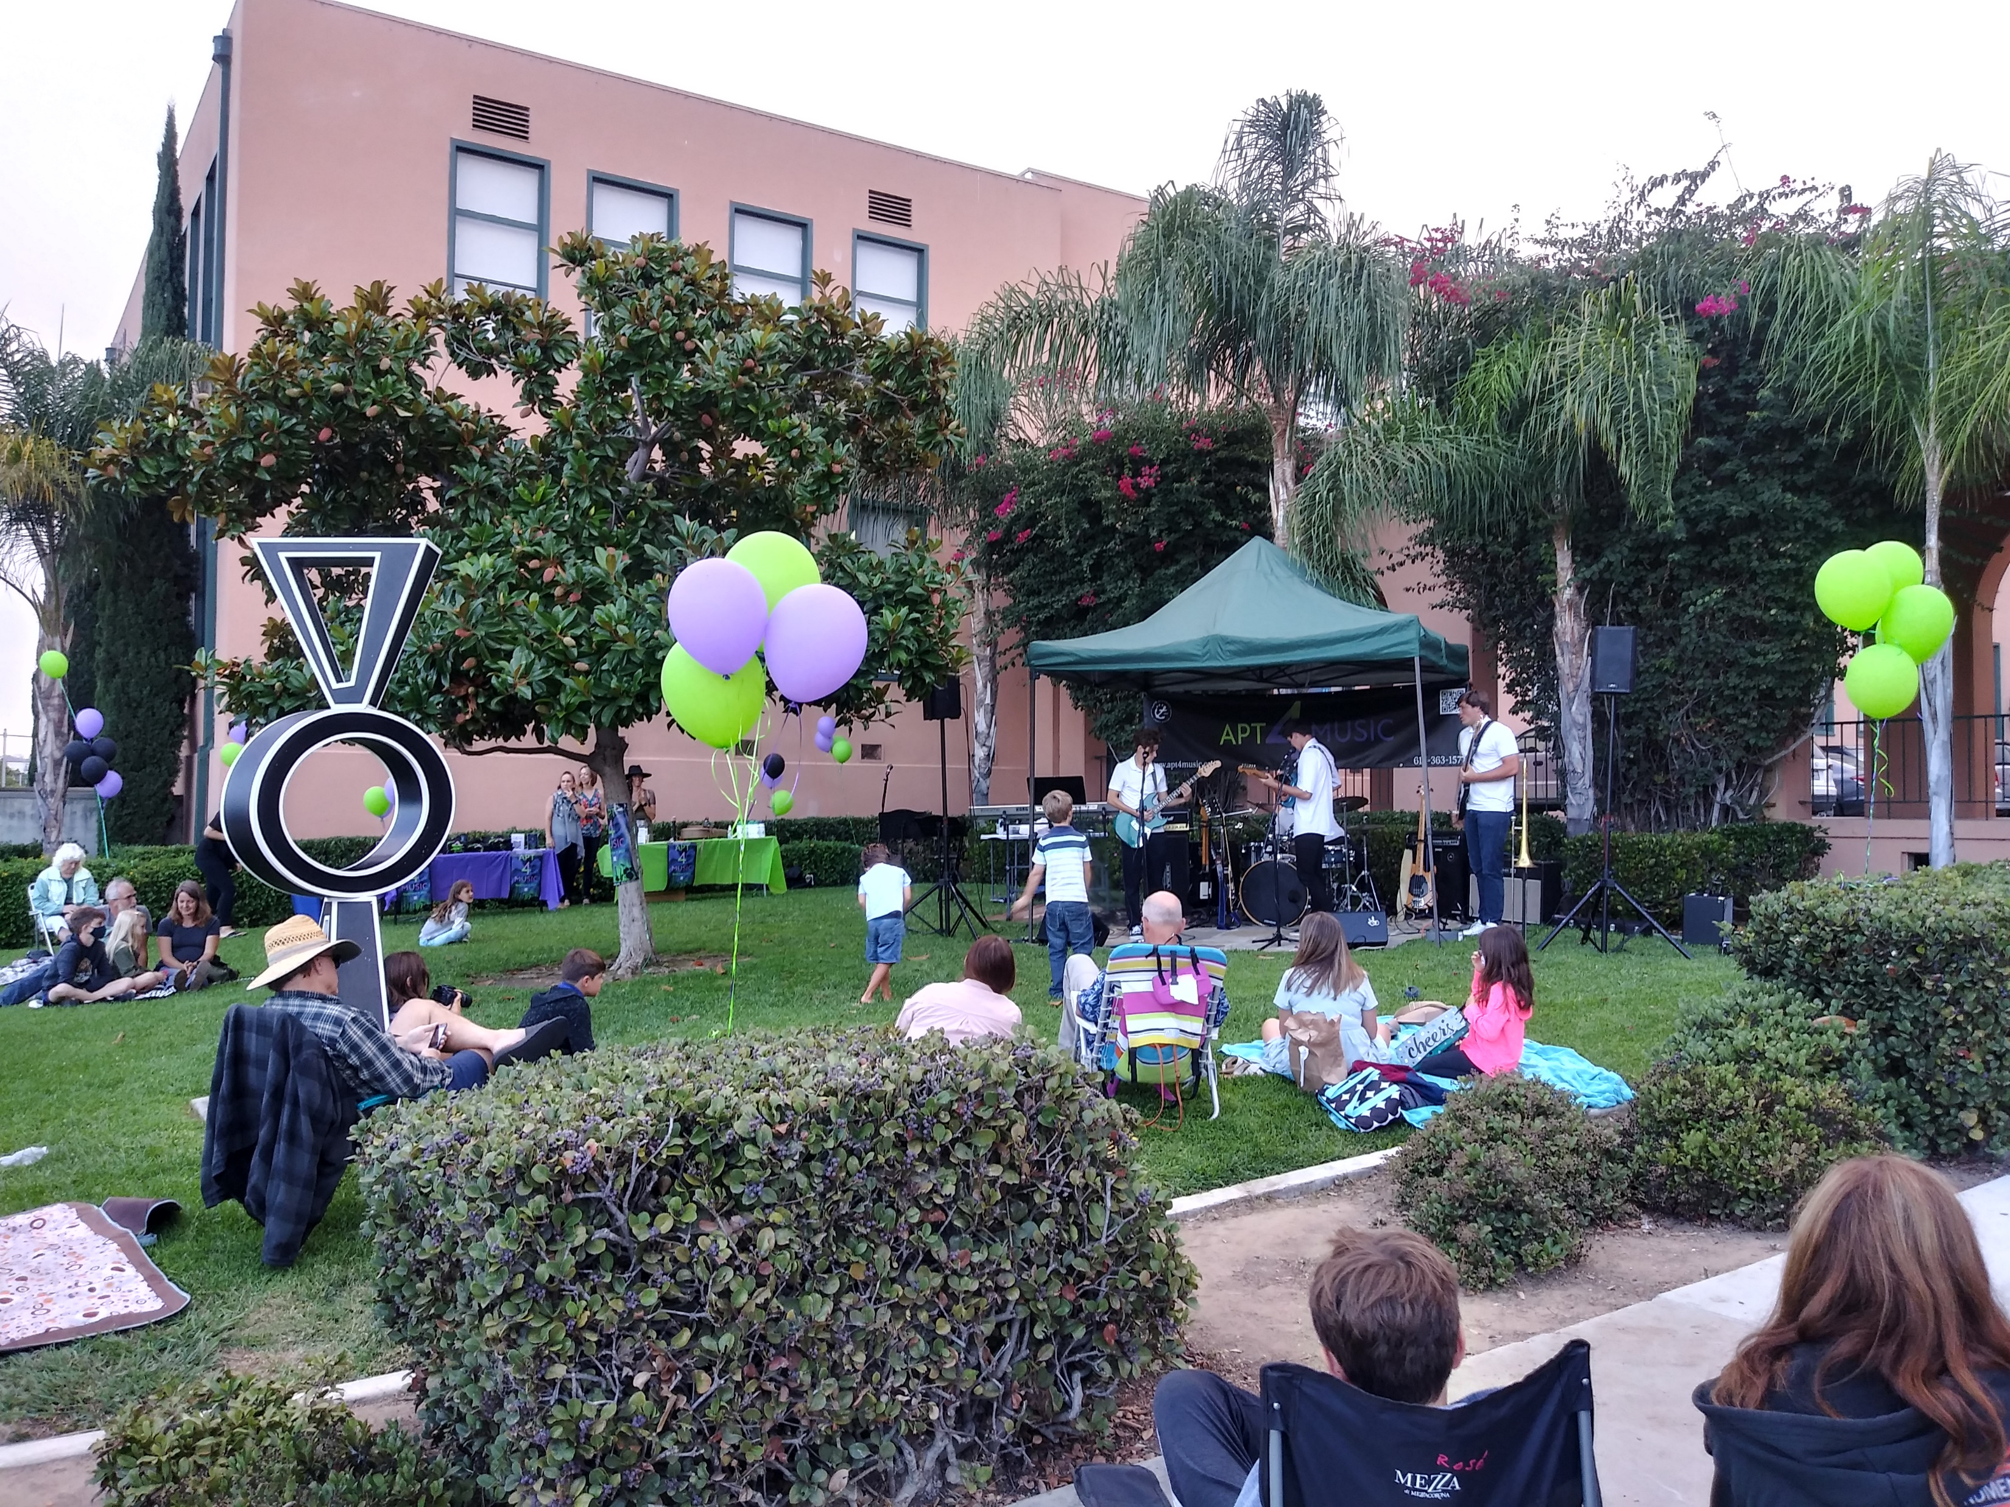
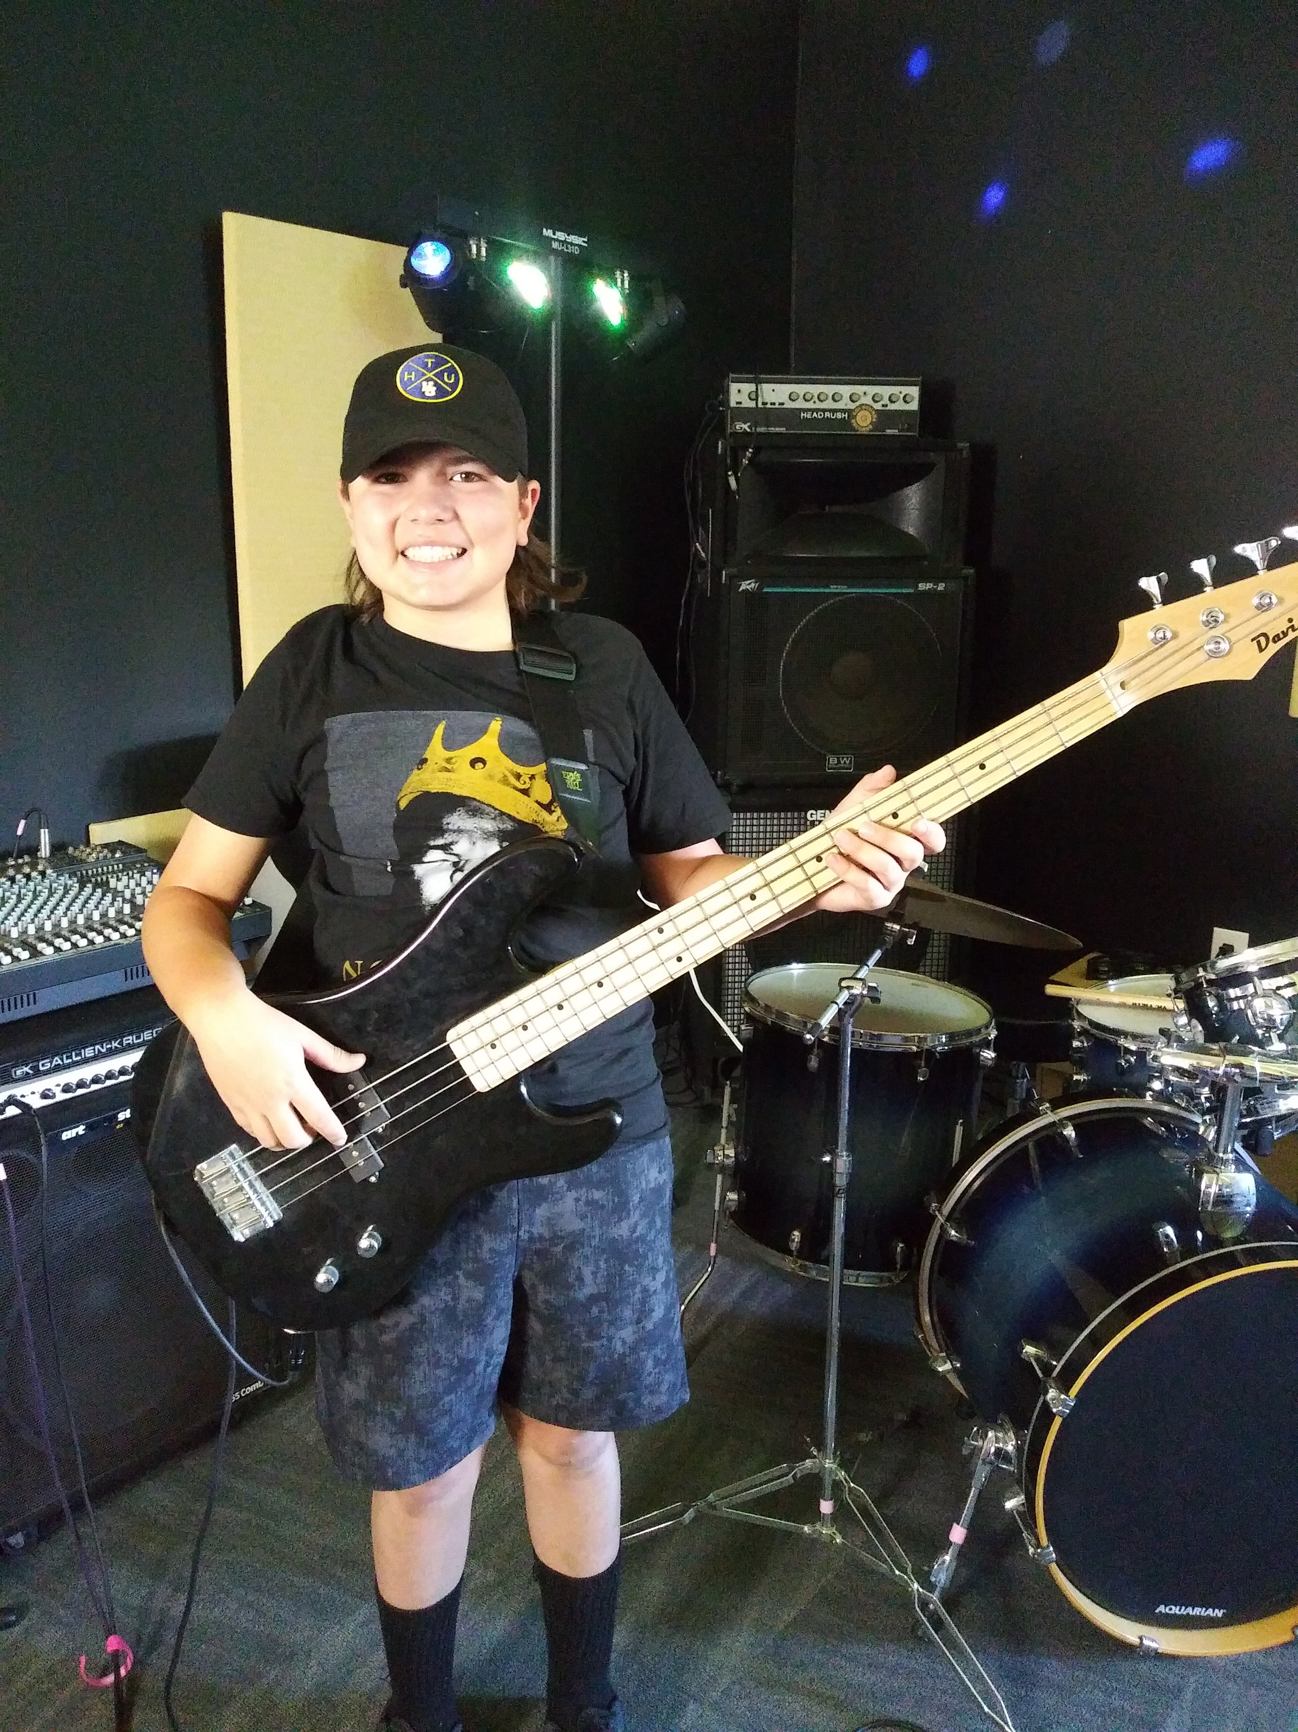
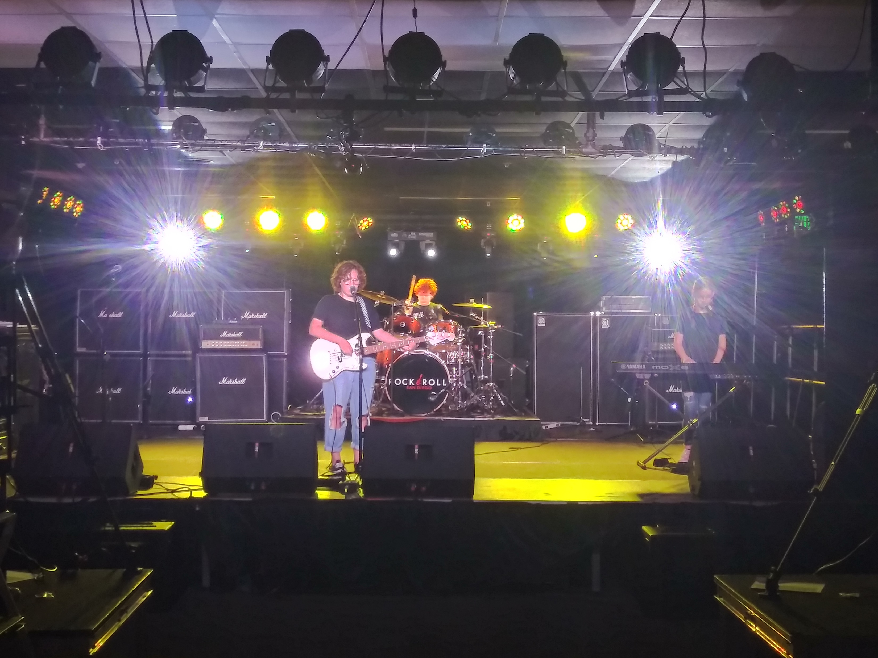
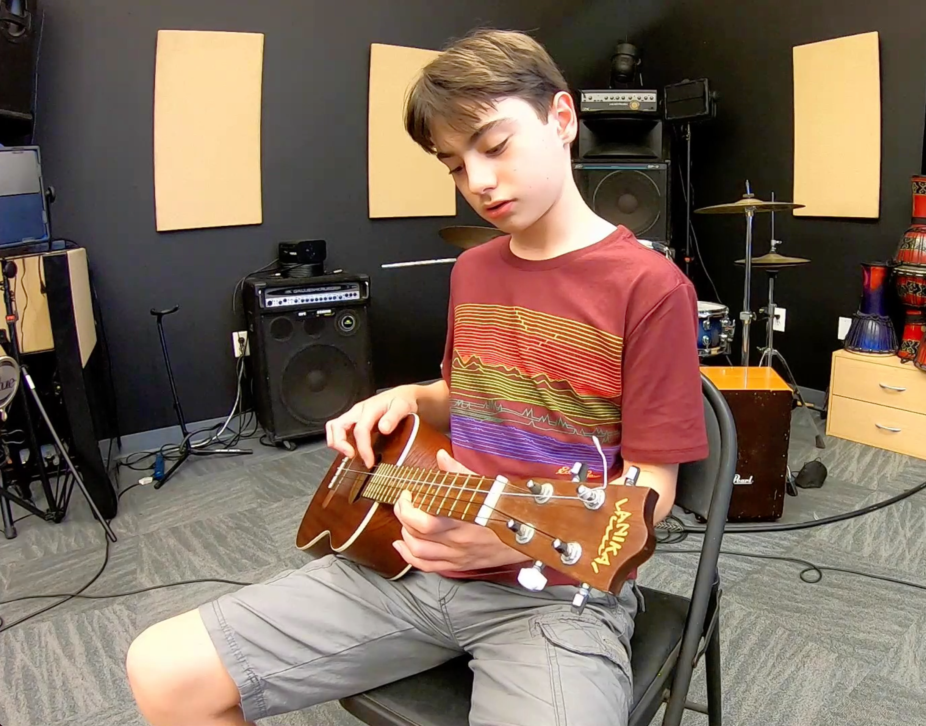
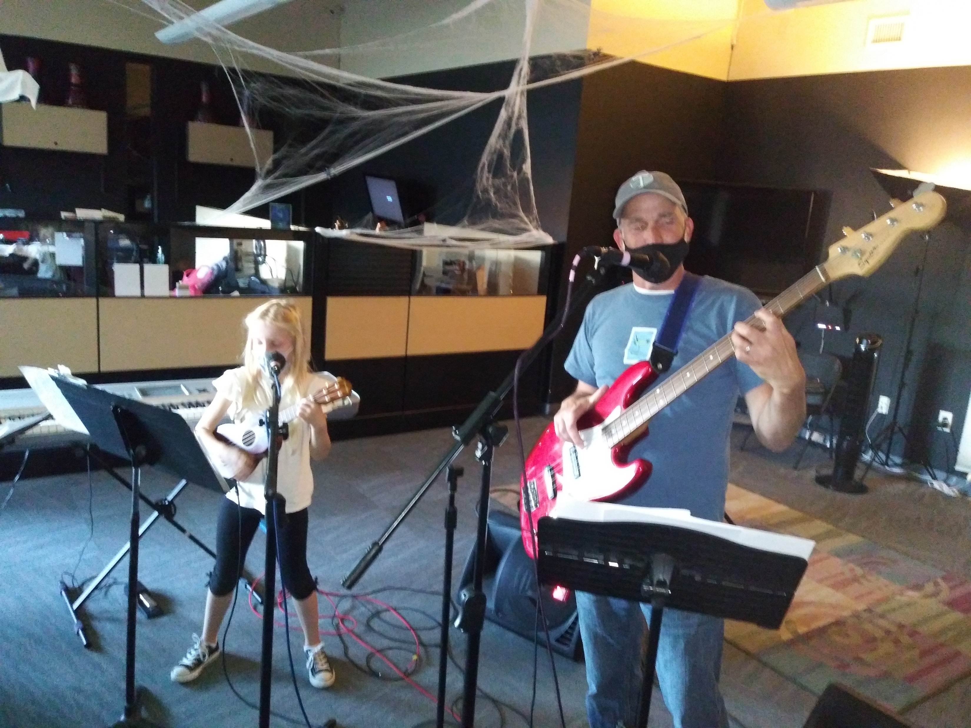

Slide 11
Apt 4 Music Promo

Slide 12
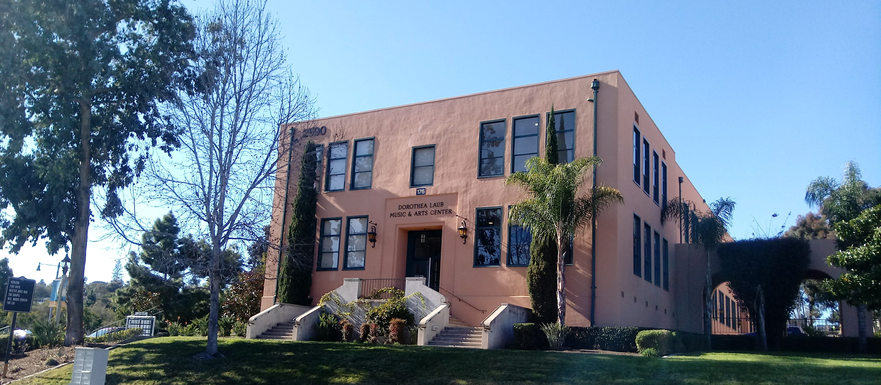
www.apt4music.org 619-363-1577

